Slide 1

Stock price Prediction
Jyoti
ADMN 5016
AI project

Slide 2
AGENDA
Stock price prediction (DEMO)
Overview
Dataset Overview
Proposed Models
Evaluation
Conclusion
Data Preparation

Slide 3
Overview
Stock markets affect the economy in different aspects as it allows small businesses to raise capital
Rising interest rates mean higher borrowing costs.
Relatively accurate share prices assist in the efficient allocation of society’s scarce capital.
But not everybody have that deep study of market or experience.

Slide 4

Goal
The model we built here will use the neural networks function to predict the stock prices.
Our aim here is to provide a machine learning technique which can predict the stock prices and accessible even by not technical person.
Help normal persons to be confident before investing in stock market.

Slide 5

Process Design
The process is done by Supervised learning Algorithm.
First, we use neural network as it allow the program to recognize patterns
It acts as a guide to teach the algorithms what conclusion it should produce.

Slide 6
Stock price predictor (DEMO)
Overview
Dataset Overview
Data Preparation
Proposed Models
Evaluation
Conclusion

Slide 7
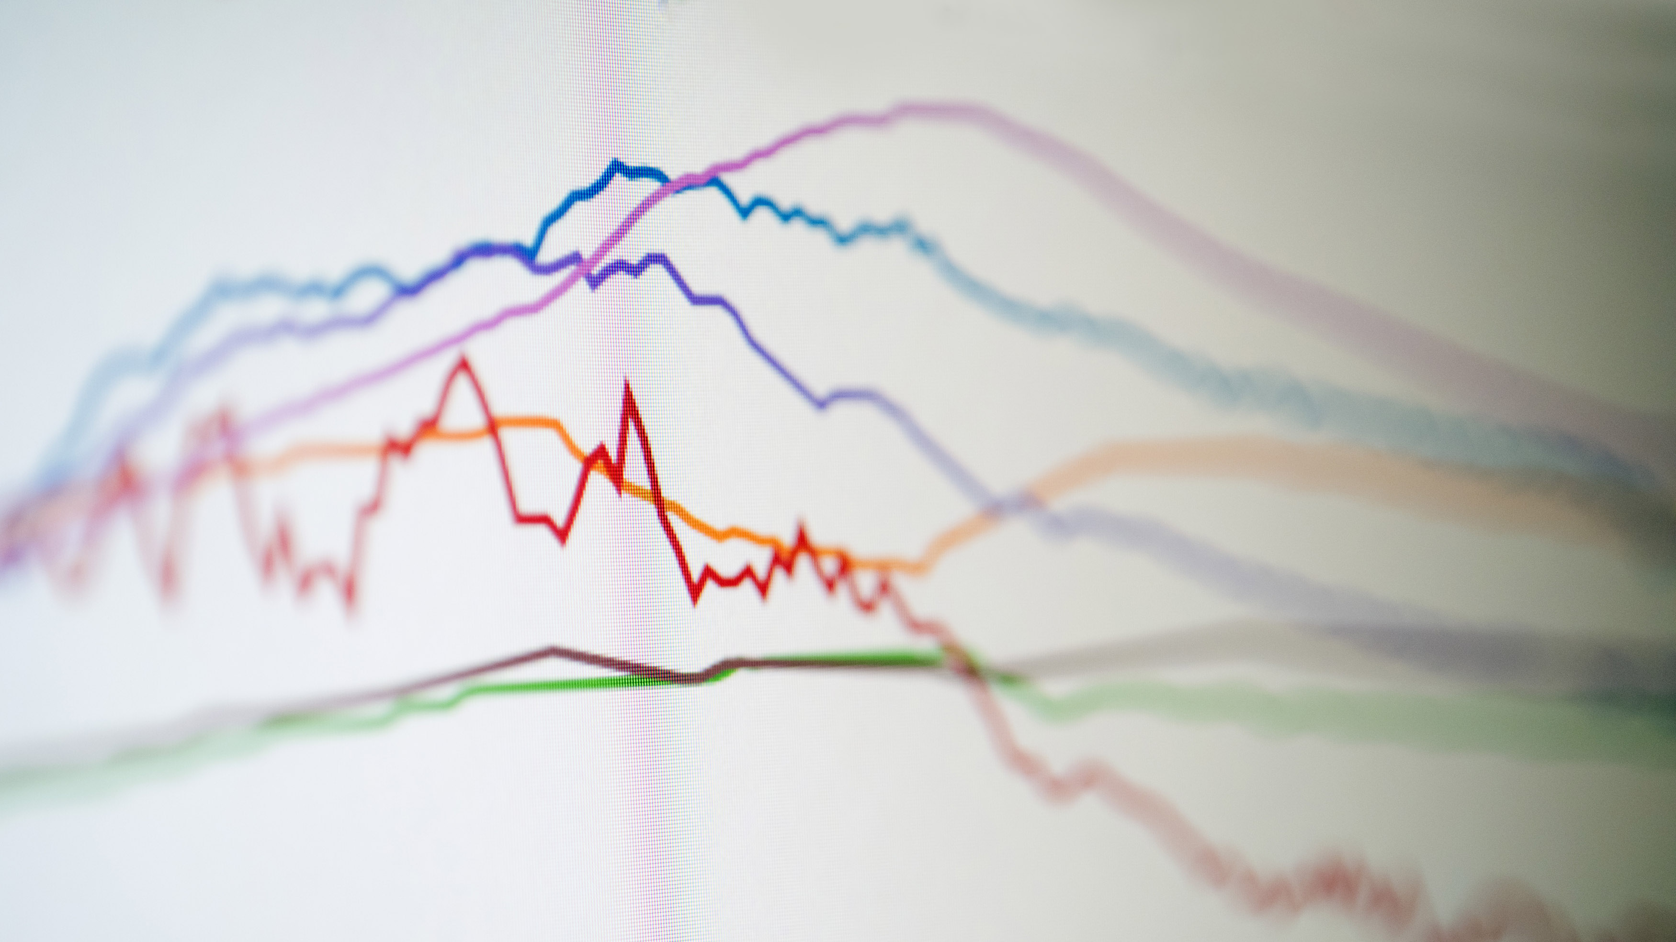
Dataset Overview
Dataset- national stock exchange, India
Attributes: 8
Tuples: 1235

Slide 8
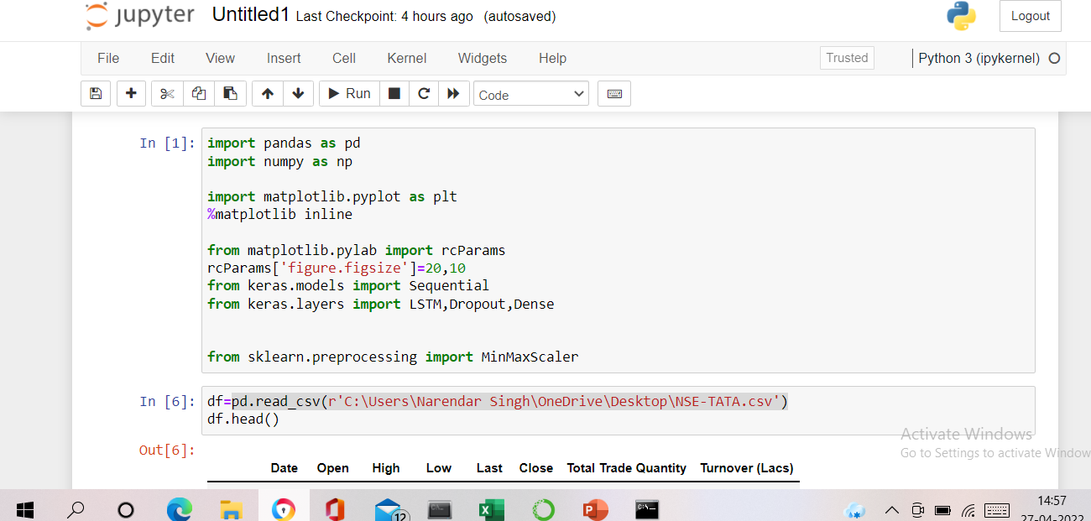

Slide 9
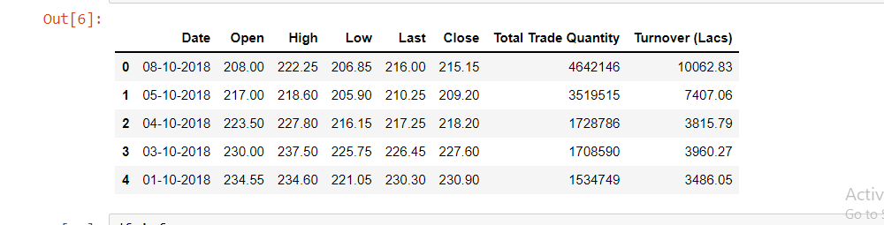
Continue…

Slide 10
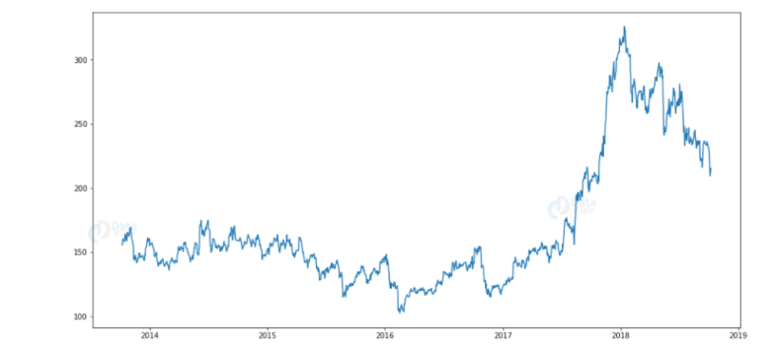
Analysing the closing prices for the dataset

Slide 11
Stock price predictor (DEMO)
Overview
Dataset Overview
Data Preparation
Proposed Models
Evaluation
Conclusion

Slide 12
Data Preprocessing
Sort the dataset on date time and filter “Date” and “Close” columns
Normalize the new filtered dataset

Slide 13
Stock price predictor (DEMO)
Overview
Dataset Overview
Data Preparation
Proposed Models
Evaluation
Conclusion

Slide 14
Proposed Models
Build and train the LSTM model
Take a sample of a dataset to make stock price predictions using the LSTM model

Slide 15
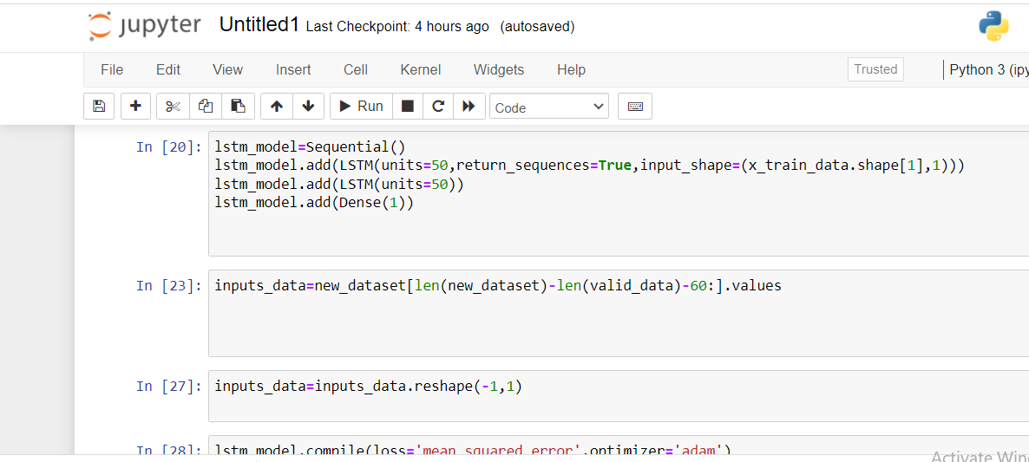

Slide 16
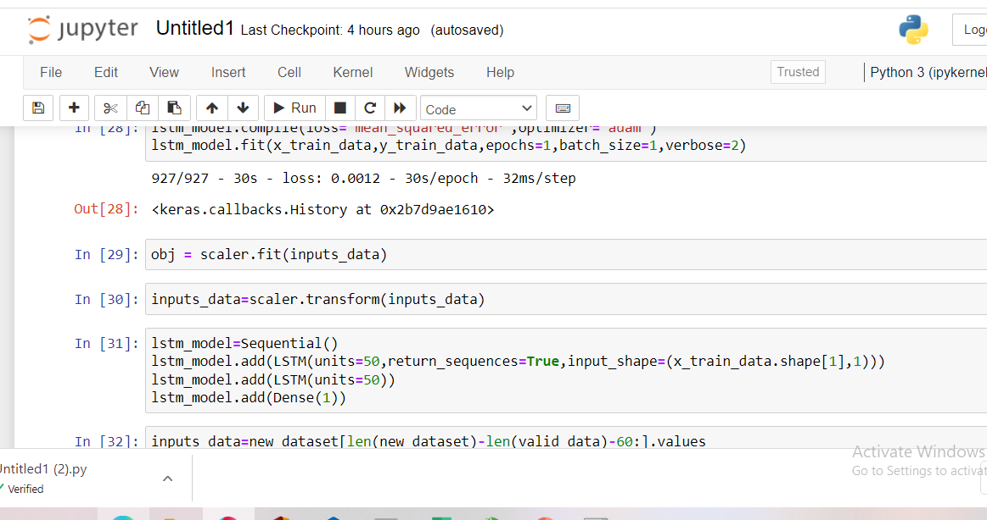

Slide 17
Credit Card Default Problem (DEMO)
Problem Overview
Dataset Overview
Data Preparation
Proposed Models
Evaluation
Conclusion

Slide 18
Evaluation Process
Evaluation Metrics:
We implemented stock market prediction using the LSTM model. OTOH, Plotly dash python framework for building dashboards.

Slide 19
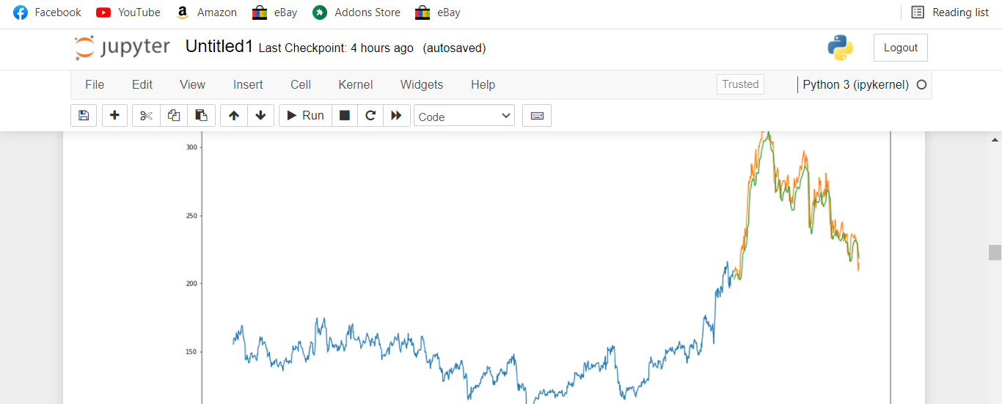
Model Output

Slide 20
Stock Price predictor (DEMO)
Overview
Dataset Overview
Data Preparation
Proposed Models
Evaluation Process
Conclusion

Slide 21
Conclusion
We Investigate and sorted the data for misbalancing and normalize.
Then We use neural network which is a great approach when it comes to see patterns.
By using the LSTM model, we checked it is quite accurate to predict the stock price.

Slide 22
Stock price predictor (DEMO)
Overview
Dataset Overview
Data Preparation
Proposed Models
Evaluation Process
Conclusion

Slide 23
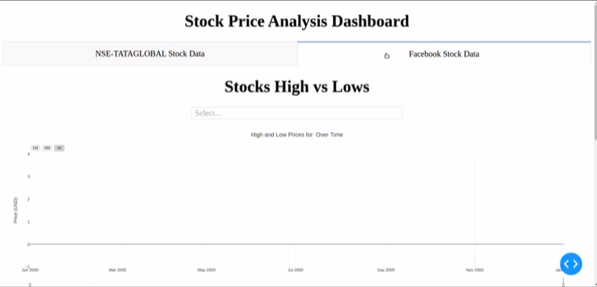
Demo

Slide 24

THANK YOU

